Slide 1
Design And Analysis of Algorithms Project UE17CS251

Slide 2
AVL TREES
By
Naveen Karthik MJ
PES1201701611

Slide 3
Aim of the Project
Implementing AVL trees using C

Slide 4
Features of the project
Insertion
Deletion
Searching
Preorder
Postorder
Inorder
Print Balance Factors

Slide 5
What are AVL trees?
AVL tree is a self-balancing Binary Search Tree (BST) where the difference between heights of left and right subtrees cannot be more than one for all nodes.

Slide 6
Why use AVL trees?
Most of the BST operations (e.g., search, max, min, insert, delete.. etc) take O(h) time where h is the height of the BST. The cost of these operations may become O(n) for a skewed Binary tree. If we make sure that height of the tree remains O(Logn) after every insertion and deletion, then we can guarantee an upper bound of O(Logn) for all these operations. The height of an AVL tree is always O(Logn) where n is the number of nodes in the tree.

Slide 7
AVL Trees Insertion(1)
To make sure that the given tree remains AVL after every insertion, we must augment the standard BST insert operation to perform some re-balancing. Following are two basic operations that can be performed to re-balance a BST without violating the BST property (keys(left) < key(root) < keys(right)). 1) Left Rotation 2) Right Rotation Steps to follow for insertion.Let the newly inserted node be w 1) Perform standard BST insert for w.

Slide 8
AVL Trees Insertion(2)
2) Starting from w, travel up and find the first unbalanced node. Let z be the first unbalanced node, y be the child of z that comes on the path from w to z and x be the grandchild of z that comes on the path from w to z. 3) Re-balance the tree by performing appropriate rotations on the subtree rooted with z. There can be 4 possible cases that needs to be handled as x, y and z can be arranged in 4 ways. Following are the possible 4 arrangements: a) y is left child of z and x is left child of y (Left Left Case) b) y is left child of z and x is right child of y (Left Right Case)

Slide 9
AVL Trees Insertion(3)
c) y is right child of z and x is right child of y (Right Right Case) d) y is right child of z and x is left child of y (Right Left Case) Following are the operations to be performed in above mentioned 4 cases. In all of the cases, we only need to re-balance the subtree rooted with z and the complete tree becomes balanced as the height of subtree (After appropriate rotations) rooted with z becomes same as it was before insertion

Slide 10
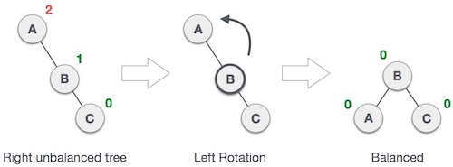
Left Left Case

Slide 11
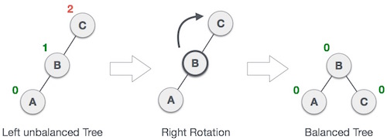
Right Right Case

Slide 12
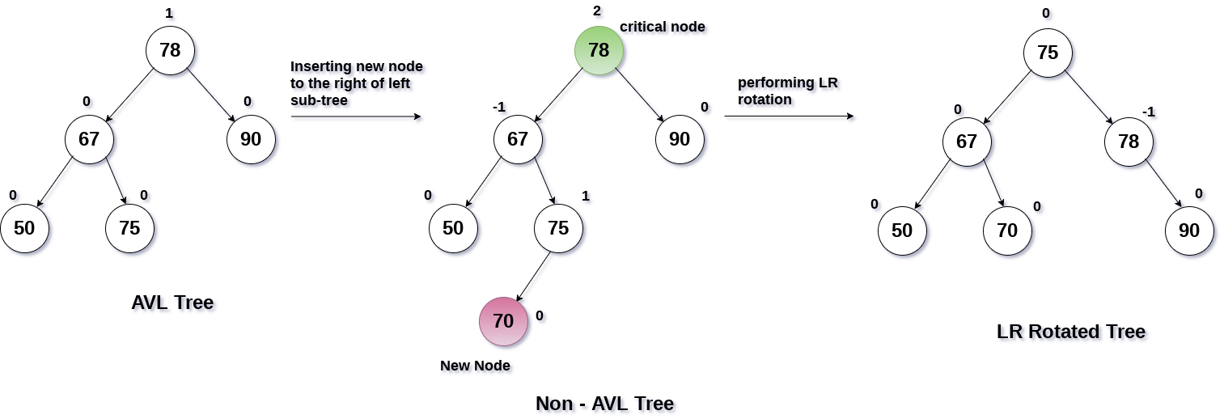
Left Right Case

Slide 13
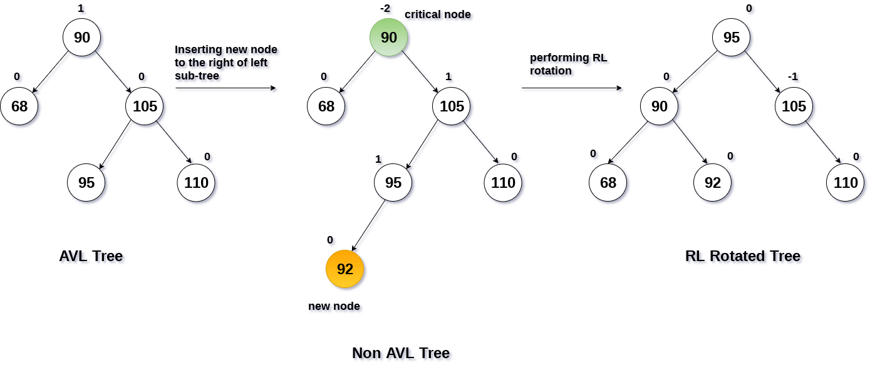
Right Left Case

Slide 14

Input in the program

Slide 15



Traversals:
All three traversals i.e pre-order,in-order,post-order are implemented in same way as any other binary tree is traversed through

Slide 16

Balance Factors:
As mentioned earlier balance factors determine the position of elements. It is the difference of heights of its subtrees.

Slide 17

Deletion:
To make sure that the given tree remains AVL after every deletion, we must augment the standard BST delete operation to perform some re-balancing. We use the same properties we used while inserting to make sure the resulting tree is an AVL tree.

Slide 18


Other basic operations:
Other basic operations like search and deletion of whole tree are similar to any other binary trees.

Slide 19
REFERENCES
Introduction to Design and Analysis of Algorithms by Anany Levitin.
https://www.geeksforgeeks.org/
https://www.tutorialspoint.com

Slide 20
Thank You

